Slide 1
Programming With Objects
CEIS150
Susan Konczal

Slide 2
Introduction:
In this project I utilized my previous Python skills and incorporated the new skills from CEIS150 to create a stock tracking application.

Slide 3
Module 1
Software Environment Setup

Slide 4
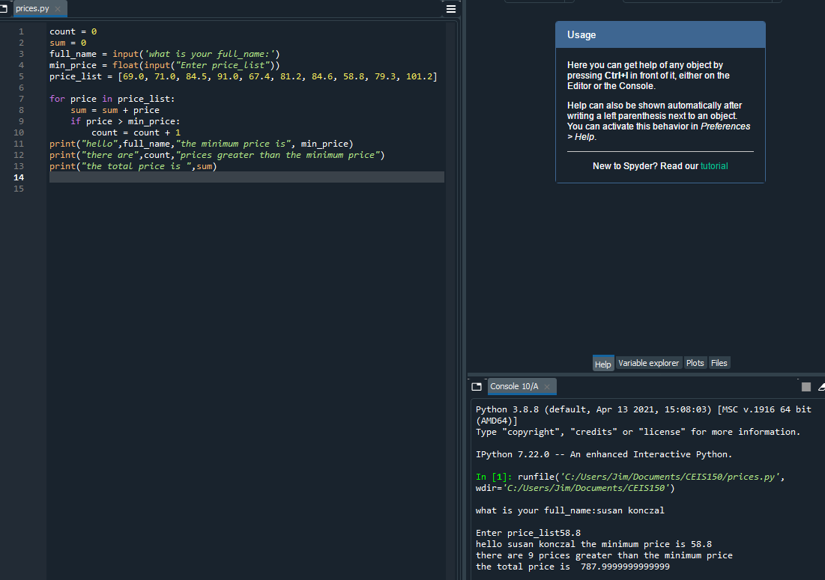
Program
Screen shot of Python program running successfully on Spyder Software.

Slide 5
Module 2
Class Diagrams
Class Coding
Unit Testing

Slide 6
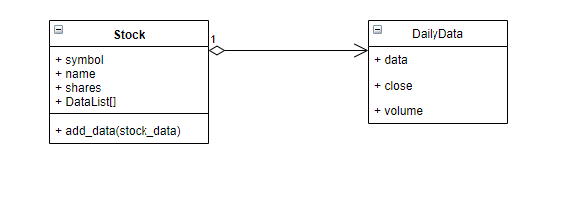
Class Diagram
Paste your Visio Class Diagram

Slide 7
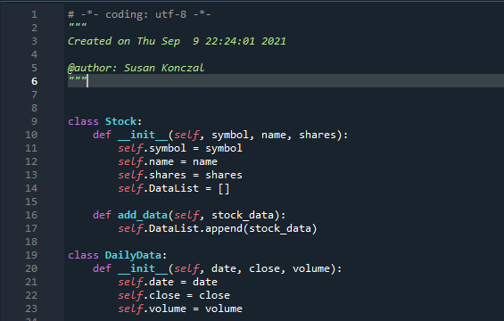
Class Code
Screen Shot of your stock_class.py file.

Slide 8
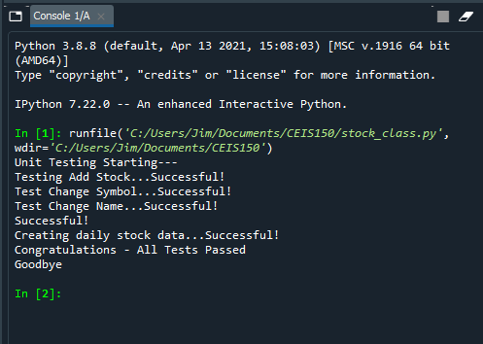
Unit Test
Screen Shot of your successful unit test.

Slide 9
Module 3
Text-Based User Interface
Summary Report

Slide 10
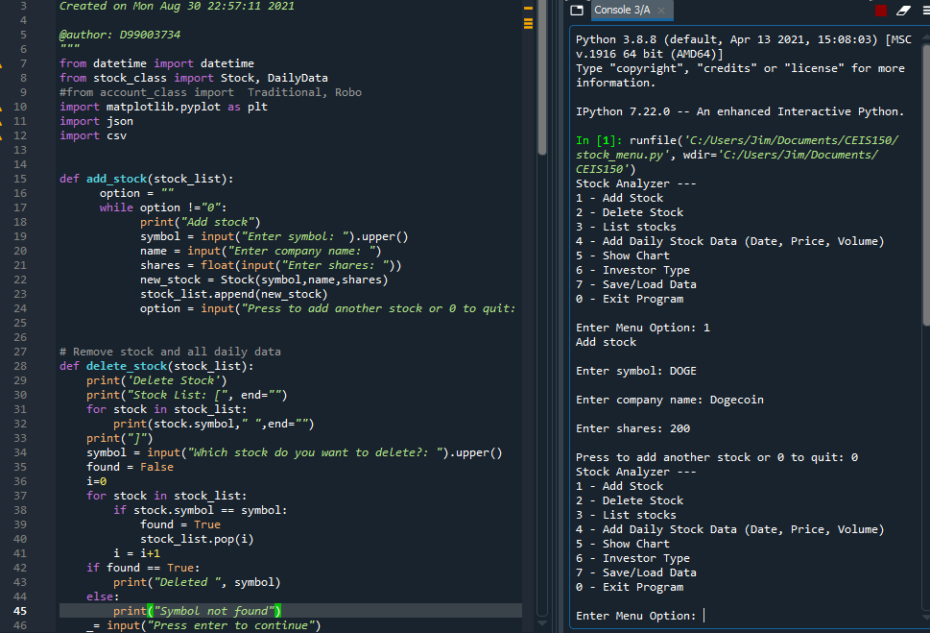
Adding a Stock
Paste a screen shot of your working Stock program.

Slide 11
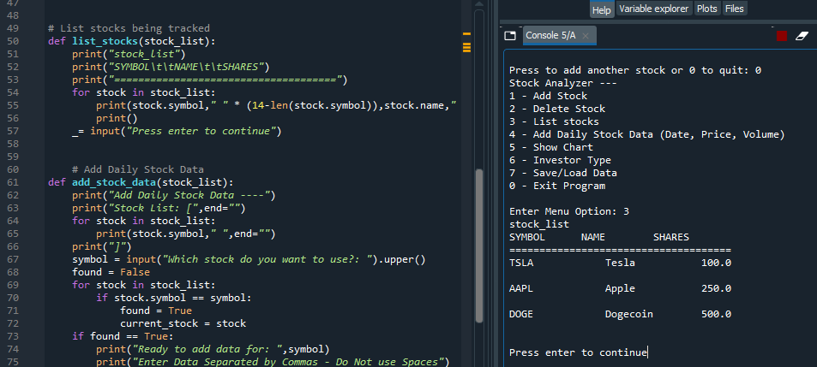
Listing 3 Stocks
Paste a screen shot of your working Stock program.

Slide 12
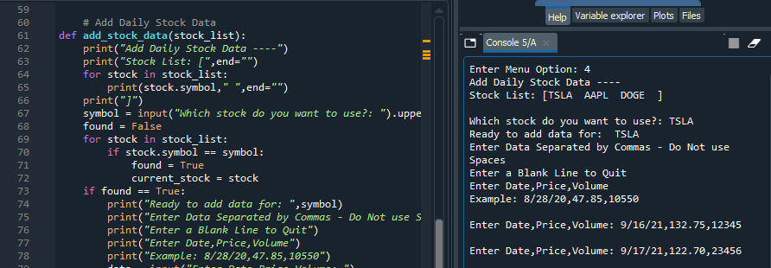
Daily Data
Paste a screen shot of your working Stock program.

Slide 13
Module 4
Inheritance
Summary Report

Slide 14
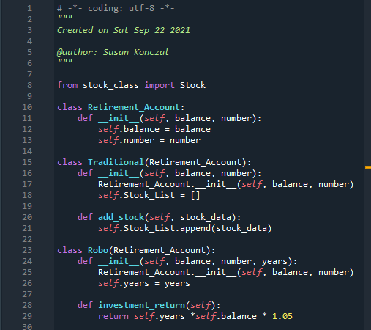
Inherited classes
Paste a screen shot of your classes

Slide 15
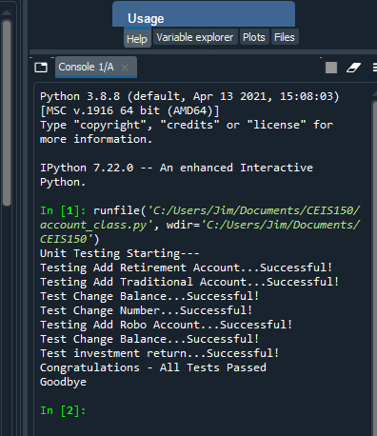
Unit Tests
Paste a screen shot of your unit tests successfully completed

Slide 16
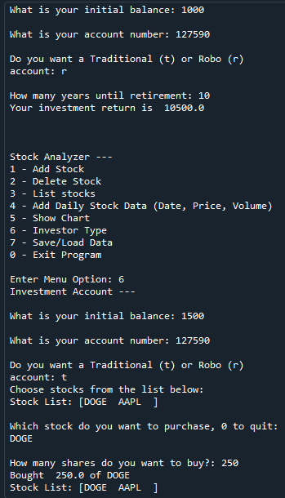
Stock menu program
Paste a screen shot of your classes in the main program

Slide 17
Module 5
Creating a Chart

Slide 18
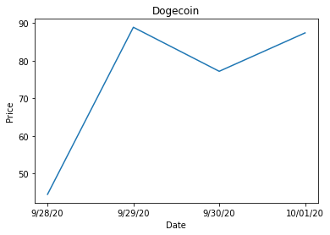
Chart
Paste a screen shot of your stock chart.

Slide 19
Module 6
Saving Data

Slide 20
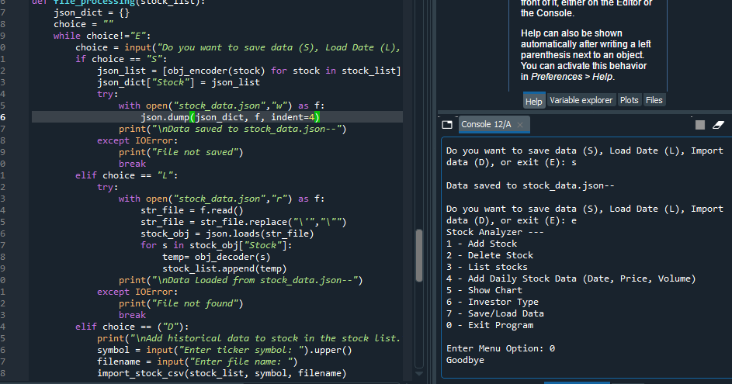
Saving Data
Paste a screen shot of the data saved to a file

Slide 21
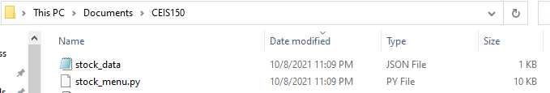
File
Paste a screen shot of the file created in file explorer

Slide 22
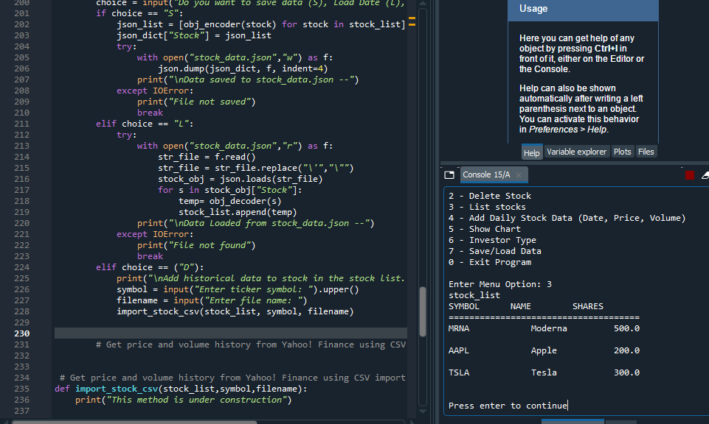
Loading Data
Paste a screen shot of stock listing

Slide 23
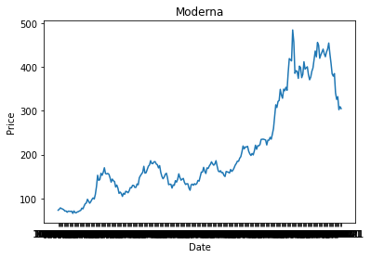
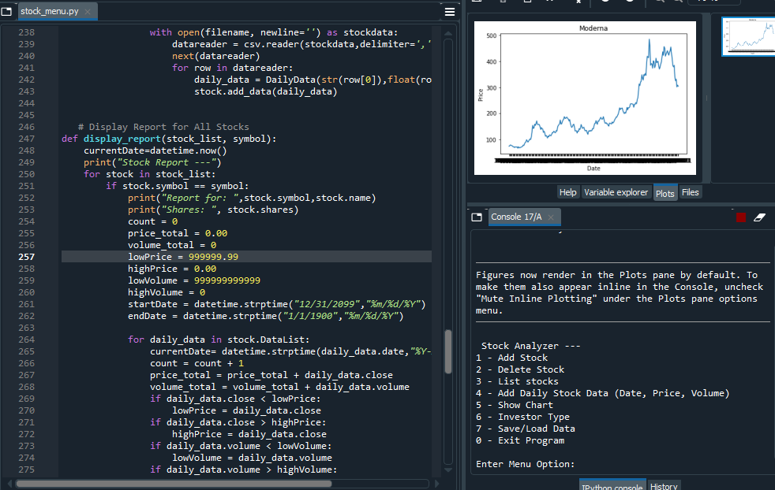
Importing data
Screenshot of the historical data import

Slide 24
Module 7
GUI

Slide 25
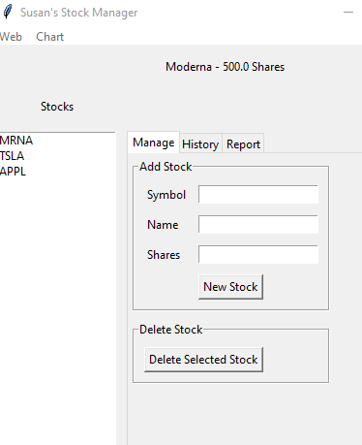
Stocks in GUI
Paste a screen shot of your GUI working

Slide 26
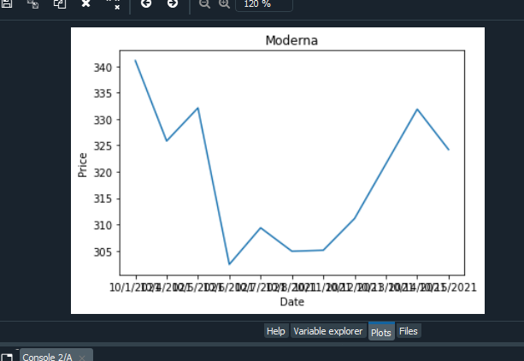
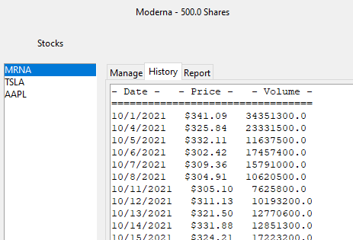
History Tab
Paste a screen shot of your History tab with import working.

Slide 27
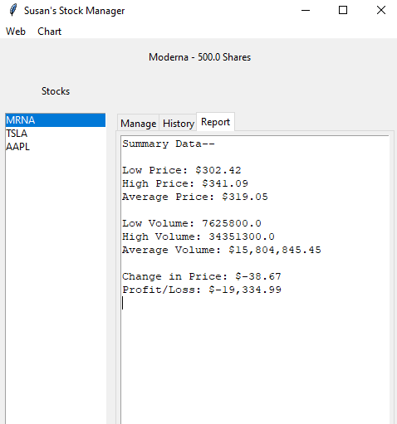
Report Complete
Paste a screen shot of your Report tab

Slide 28
Career Skills:
Learned how to create a working GUI
Learned how to create a chart and get historical stock data from Yahoo! Finance
Used Python Libraries to create charts
Web scraping & importing CSV files
Used OOP techniques to create a working stock tracking application

Slide 29
Challenges:
In the beginning of this project, it was hard to turn pseudo code into working code. As time went on it became easier with practice, but also following the guidance of the professors each week.

Slide 30
Conclusion:
My finished project in CEIS150 has helped me develop software setup skills, trouble shooting skills, use basic Python Programming, but also learn various object-oriented techniques. The result of my completion in CEIS150 will incorporate the many aspects of coding and prepare me for my future career.

